Slide 1
Software-Based Real Random Number Generator
Creating Randomness with Time and CPU Speed
Team Members :-
Rishi
Akshay
Khushi
Shyam Sunder Sharma
Mail Id:-
rishiarorahr@gmail.com
akshaysati2002@gmail.com
khushijhodkan@gmail.com
shyamsunders0708@gmail.com

Slide 2
Introduction
A Synopsis of the Project's Objective:-
The creation of a software-based real random number generator is the main objective of this research. Our method, which differs from conventional pseudorandom number generators, focuses on using sophisticated software methods to provide actual unpredictability. Our goal is to develop a generator that generates unbiased and surprising numerical sequences by employing advanced approaches.

Slide 3
The Value of Randomness in a Range of Applications:-
In many different fields, such as statistical analysis, secure key creation, simulations, gaming, and cryptography, random numbers are essential.
Ensuring the security and dependability of these applications requires the capacity to produce truly random integers.
The requirement for high-quality randomness across a variety of domains and applications is addressed by our initiative.

Slide 4
Motivation:-
Why Create a Software-Based Random Number Generator:-
Software-based random number generators are preferred because of their adaptability, simplicity of use, and compatibility with a wide range of operating systems.
Software-based generators, which provide flexibility and wide application, generate random-like sequences using algorithms as opposed to hardware-based methods.

Slide 5
Potential Applications and Use Cases:-
Cryptography and Secure Communication:-
Software-based random number generators are often used in cryptography to generate keys and initialization vectors. They play an important role in maintaining communication security and secrecy.
Simulation and modelling:-
Software-based random numbers are vital in simulations and mathematical modelling to create realistic situations, generate random inputs, and provide statistically valid outcomes.
.

Slide 6
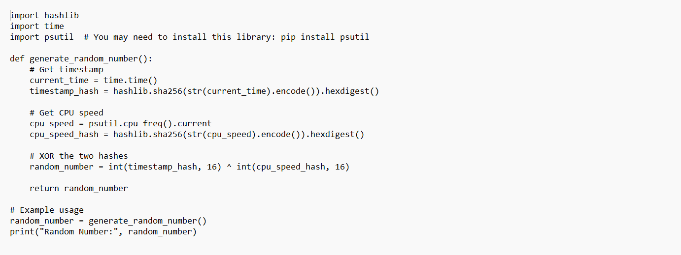
Code Example :

Slide 7
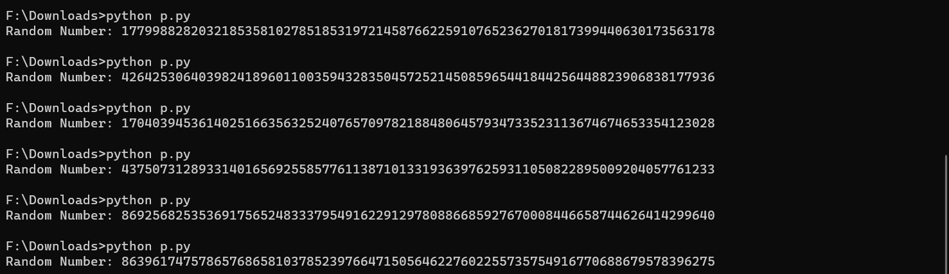
OUTPUT

Slide 8
Conclusion :
In conclusion, we have explored the development of a Software-Based Real Random Number Generator, leveraging a combination of timestamp and CPU speed. The methodology involves timestamp retrieval, hashing, CPU speed retrieval, hashing again, and finally, XORing the two hashed values.
The project addresses the need for randomness in various applications, emphasizing its significance in cryptography, secure key generation, simulations, gaming, statistical analysis, and more.
The combination of software-based approaches offers flexibility, accessibility, and ease of implementation across diverse platforms.

Slide 9

Q&A:
Thank you for your attention to our presentation on the Software-Based Real Random Number Generator. We now invite you to ask any questions or share your thoughts on the project.
Mail id’s :
rishiarorahr@gmail.com

Slide 10
Thank You

